Slide 1
Study Jam Machine Learning 2: Math For Machine Learning #2

Slide 2





Co-Lead GDGoC Widyatama University
Informatics student at Widyatama University
Bangkit Alumni 2024 batch 1
On Campus Widyatama University
instagram.com/m.syahrindra
linkedin.com/in/m-syahrindra/
M Syahrindra Core Team
github.com/syahrindra

Slide 3
Today’s Topic
Derivative
Optimization

Slide 4
Other Resources
YouTube: Kylie Ying, 3Blue1Brown, stanford online, bermatematika etc
Coursera: Machine Learning courses
Udemy:Machine Learning courses
Dicoding, DataCamp, etc

Slide 5


Slide 6
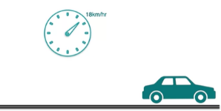
Derivatives
Turunan adalah laju perubahan fungsi sesaat

Slide 7
Derivatives
Berdasarkan informasi yang tersedia? Bisa ga kita menentukan jarak pada t = 12.5
T (detik) | X (meters
0 | 0
5 | 36
10 | 122
15 | 202
20 | 275
25 | 351

Slide 8
Quiz 1: Slop of a line
Berdasarkan informasi yang tersedia? Bisa ga kita menentukan velocity pada t = 12.5
T (detik) | X (kecepatan)
0 | 0
5 | 36
10 | 122
15 | 202
20 | 275
25 | 351
Hitung rata-rata kecepatan mobil pada interval 10-15 detik?
(122+202)/2 = 162

Slide 9
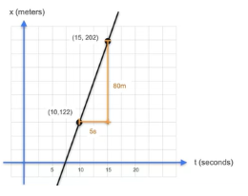
slope= rise/run
Slope = perubahan jarak/ perubahan waktu
= 202-122 m / (15-10) s
=80/5 = 16 m/s

Slide 10
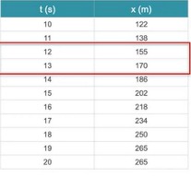
Quiz 2: Slop of a line
Bisa ga? Perkiraan berapa kecepatannya ketika t=12.?
Slope =
(170-155)/(13-12)
=15/1
Slope = 15m/s

Slide 11
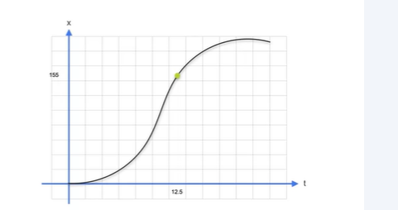
Derivative

Slide 12
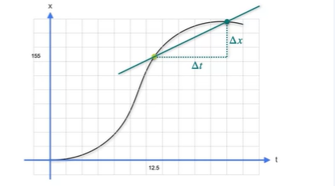
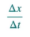

Slide 13
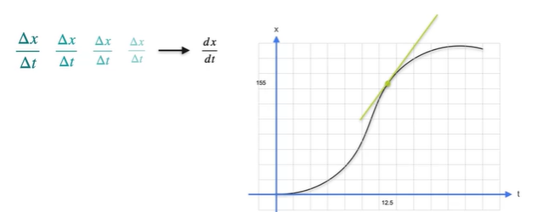

Slide 14
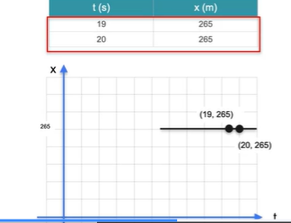
Zero slope
Slope = deltax/deltay
= 265-265/20-19
= 0/1 = ga ada
Slope = ga ada peningkatan jarak

Slide 15
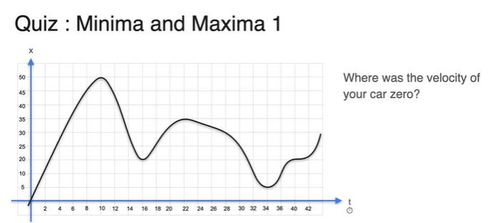

Slide 16
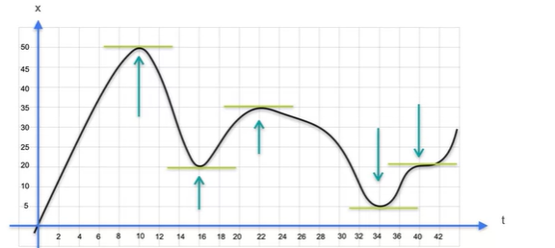

Slide 17
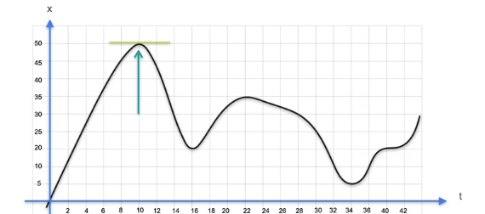

Slide 18
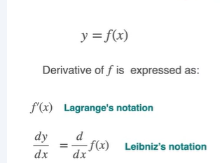
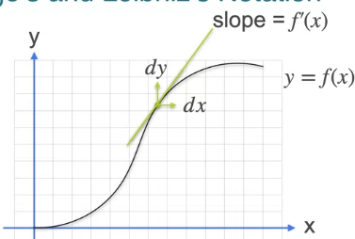
Notasi turunan = lagrange’s dan leibniz’

Slide 19
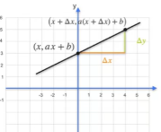
Turunan dari sebuah garis
f(x) = ax + b = f’(x) = a
Delta y/deltax = rise/run
df/dx delta y/deltax =
a(x = deltax) +b - (ax+b)/ delta x
= adeltax/deltax = a
f(x) = 2x + 213
f’(x) = 2
f(x) = x
f’(x) =

Slide 20
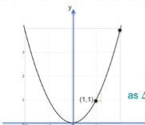

Y = f(x) = x^2
Slopenya
deltaf/deltax
= f(x+deltax)2 - f(x) / deltax
= deltaf/deltax
= (x+deltax)2 - x^2/ deltax
=x^2 + 2xdeltax + (deltax)^2 -x^2/ deltax
= 2x+deltax
f(x) = x^2
f’(x) = 2x

Slide 21
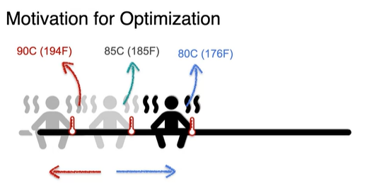
Optimization

Slide 22
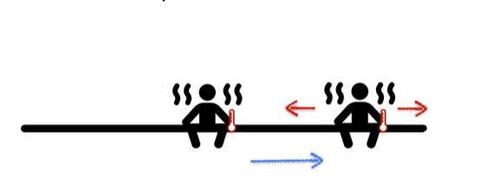

Slide 23
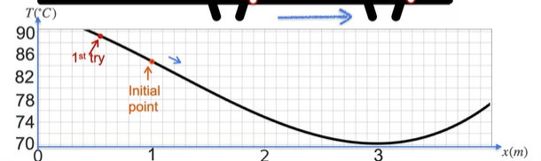

Slide 24

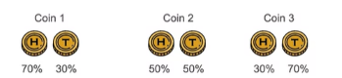
Coin Toss

Slide 25
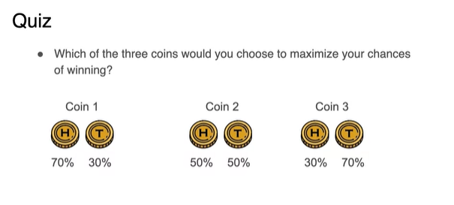

Slide 26
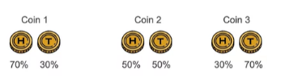
Coin 1: 0.7*0.7*0.7*…*0.3*0.3*0.3 = 0.7^7 0.3^3 = 0.00222
Coin 2: 0.5*...0.5 =0.00097
Coin 3: 0.3*0.3*...*0.3*0.7*0.7*0.7 =0.00008

Slide 27
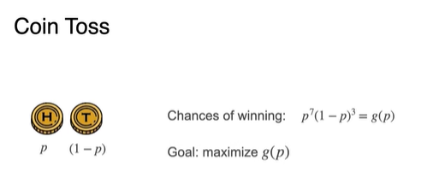
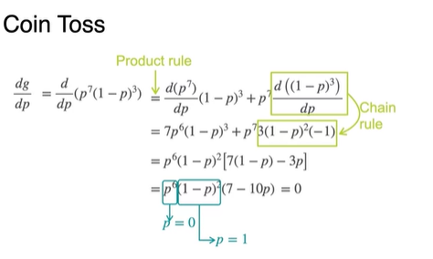
P = 0.7

Slide 28
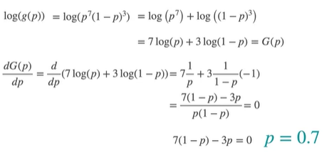

Slide 29
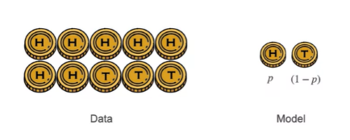

Slide 30
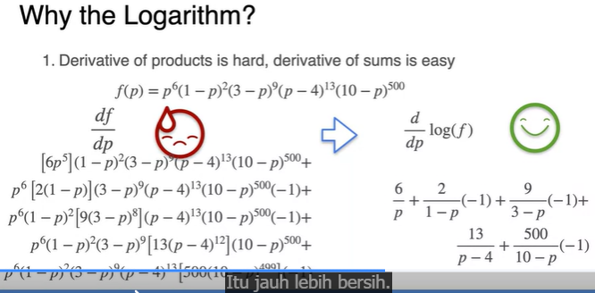

Slide 31
Break 7 menit

Slide 32
Statistic

Slide 33
Mini Task-1

